Slide 1
Introduction to 3D Printing and 3D Design
By Michael McCowan
http://3dprintmd.com

Slide 2
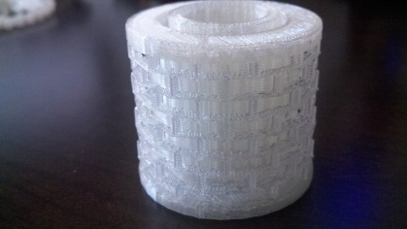
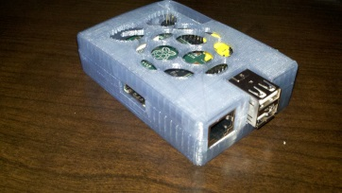
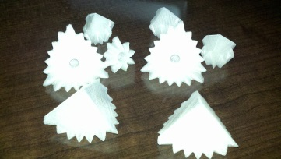
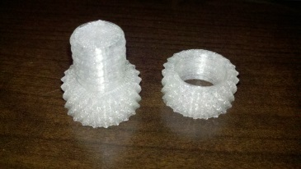
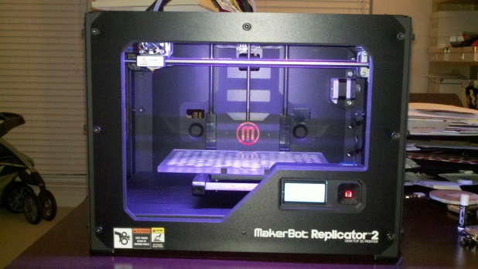
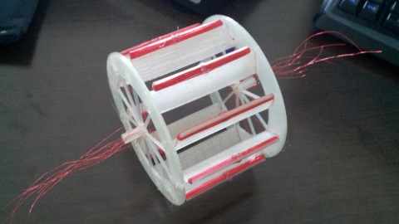
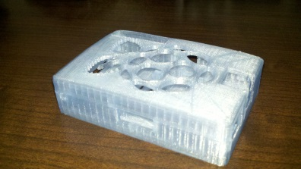
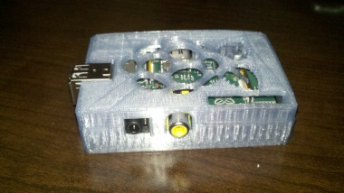
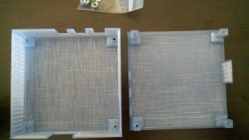
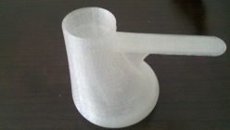
Welcome to the 3D world

Slide 3






















































































Printers

Slide 4
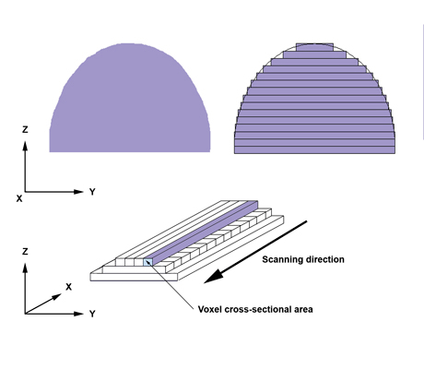
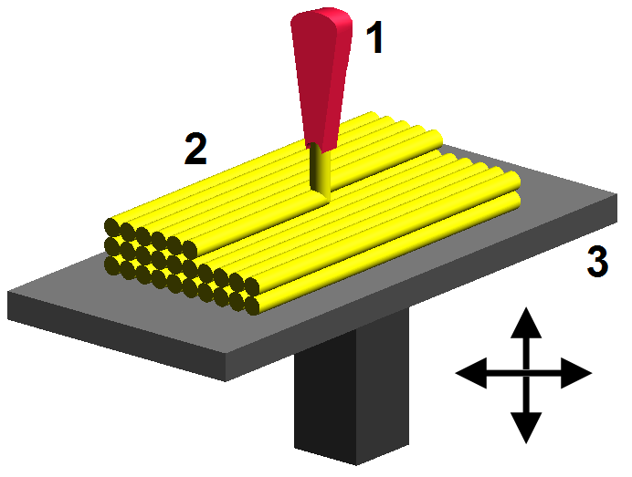
How does it work
Additive manufacturing or 3D printing is a process of making a three-dimensional solid object of virtually any shape from a digital model. 3D printing is achieved using an additive process, where successive layers of material are laid down in different shapes. 3D printing is considered distinct from traditional machining techniques, which mostly rely on the removal of material by methods such as cutting or drilling (subtractive processes).
FDM (fused depostion modeling), SLS (selective laser sintering) & SLA (stereolithograhpy) are the most widely used technologies for 3D printing.
Selective laser sintering (SLS) and fused deposition modeling (FDM) use melting or softening material to produce the layers.
Fused deposition modeling: 1 – nozzle ejecting molten plastic, 2 – deposited material (modeled part), 3 – controlled movable table

Slide 5
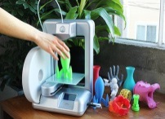
Printers
Huge variety
  $399 to $24,650+++
  Tiny 10x10x10 to huge 60x60x60 (cm)
  DIY to consumer ready product (aka Staples)
Fused Filament Fabrication (FFF), SLS (selective laser sintering), FDM (fused depostion modeling) & SLA (stereolithograhpy)
Fused Filament Fabrication (FFF) is the most widely used technology for hobby/consumer 3D printing.
Many different materials can be used for 3D printing, such as ABS plastic, PLA, polyamide (nylon), glass filled polyamide, stereolithography materials (epoxy resins), silver, titanium, steel, wax, photopolymers and polycarbonate. And even Chocolate and play dough.
Acrylonitrile butadiene styrene (ABS) and Polylactic acid or polylactide (PLA) are the most common materials
Cube 3D - $1299.99

Slide 6
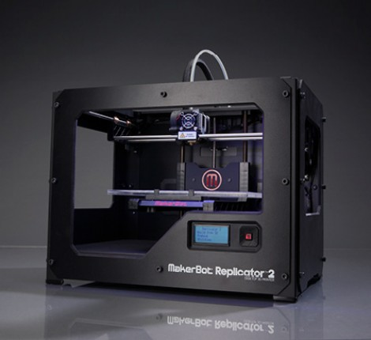
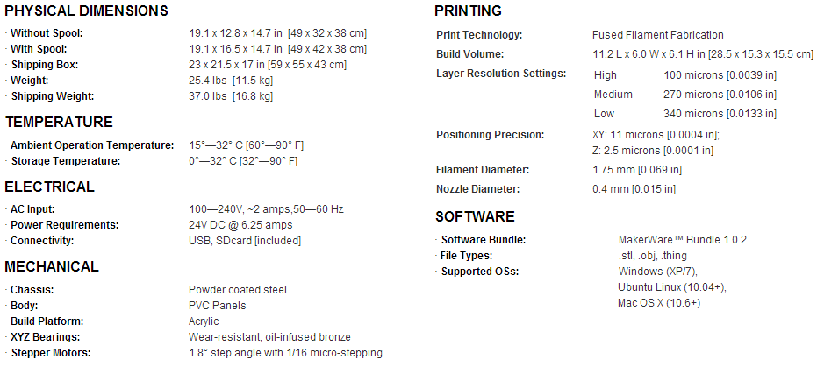
Practical Printers Today – Makerbot Replicator 2
Consumer ready product
Top seller
$2199
Excellent resolution
PLA only no ABS

Slide 7
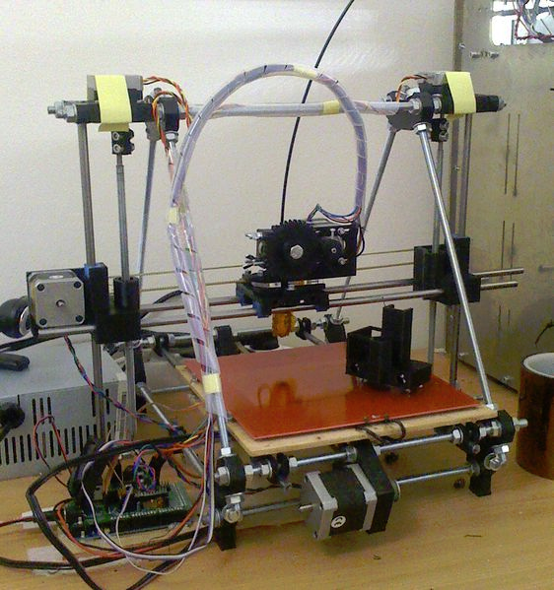
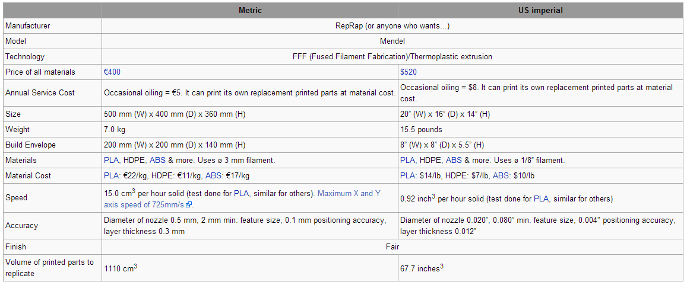
Practical Printers Today - RepRap
ABS (heated plate)
Many variants. Prusa Mendel is a good start
Optimized for self replication
DIY saves $
$520 (approx.)
Open source

Slide 8
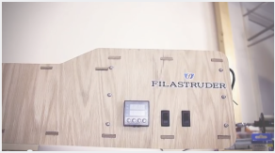
ABS vs PLA
ABS - It's strength, flexibility, machinability, and higher temperature resistance make it often a preferred plastic for engineers, and professional applications. The hot plastic smell deter some as does the plastics petroleum based origin. The additional requirement of a heated print bed means there are some printers simply incapable of printing ABS with any reliability. http://www.protoparadigm.com/blog/2013/01/the-difference-between-abs-and-pla-for-3d-printing/
PLA - The wide range of available colors and translucencies and glossy feel often attract those who print for display or small household uses. Many appreciate the plant based origins and prefer the semi-sweet smell over ABS. When properly cooled, PLA seems to have higher maximum printing speeds, lower layer heights, and sharper printed corners. Combining this with low warping on parts make it a popular plastic for home printers, hobbyists, and schools. http://www.protoparadigm.com/blog/2013/01/the-difference-between-abs-and-pla-for-3d-printing/
Material cost is approximately $28/kg shipped (ebay). Price comparison http://www.3ders.org/pricecompare/ (note that shipping costs vary greatly)
Watch for price drops soon due to cheap DIY filament extruders. http://filastruder.com/ $300 (fully assembled). $11.43 / kg http://store.osprintingllc.com/default.asp
Watch for more material to be mainstream. Nylon, High-density polyethylene (HDPE), Elasto Plastic (flexible plastic) and more.

Slide 9
Free 3D Design Software
Free 3D software: (http://www.3ders.org/3d-software/3d-software-list.html)
Google SketchUp - This Google SketchUp is fun and free, and is known for being easy to use. To build models in SketchUp, you draw edges and faces using a few simple tools that you can learn in a short time. With Push/Pull tool you can extrude any flat surface into a 3D form. Furthermore, it works together with Google Earth, that you can import a scaled aerial photograph directly from Google Earth, or use SketchUp to build models which can be seen in Google Earth.
3DCrafter - 3Dcrafter is a real-time 3D modeling and animation tool that incorporates an intuitive drag-and-drop approach to 3D modeling. The standard version of 3DCrafter is freeware. Paid versions (3DCrafter Plus and 3Dcrafter Pro) are available.
3Dtin - The simplest 3D software. You can draw directly from your browser.
Anim8or - Anim8or is a 3D modeling and character animation program.
Art of Illusion - Art of Illusion is a free, open source 3D modelling and rendering studio. Art of Illusion is more as a 3D design system for animated computer graphics than as an engineering CAD tool. More information about Hints on Using Art of Illusion for RepRap is available online.
Blender - Blender is the free open source 3D content creation suite, available for all major operating systems under the GNU General Public License. Blender was developed as an in-house application by the Dutch animation studio NeoGeo and Not a Number Technologies (NaN). It is a powerful program contains features that are characteristic of high-end 3D software.
BRL-CAD - BRL-CAD is a powerful cross-platform open source solid modeling system that includes interactive geometry editing, high-performance ray-tracing for rendering and geometric analysis, image and signal-processing tools, a system performance analysis benchmark suite, libraries for robust geometric representation. BRL-CAD has been the primary tri-service solid modeling CAD system used by the U.S. military to model weapons systems for vulnerability and lethality analyses for more than 20 years. It became an open source project on 21 December 2004.
Creo Elements/Direct - formerly CoCreate - is a complete design environment that offers direct 3D CAD modeler, along with 2D CAD, CAE and integrated product data management (PDM).
DrawPlus Starter Edition - 100% free and simple, with Accurate vector drawing program, realistic brush, pen, and pencil tools, text on a path, blend modes for advance artistic effects.
FreeCAD - FreeCAD is a general purpose Open Source 3D CAD/MCAD/CAx/CAE/PLM modeler, aimed directly at mechanical engineering and product design but also fits in architecture or other engineering specialties.
GLC Player - GLC player is a free application used to view 3d models (COLLADA 3DXML OBJ 3DS STL OFF COFF Format) and to navigate easily in these models. With the album management, capture and multi-capture capabilities, html export and navigation possibilities GLC_Player is the accurate tools to review a lot of 3D models and to create illustrations. GLC_Player is a cross-platform application (Mac, Linux and Windows). It is lighter than regular modelling software so very handy.
LeoCAD - LeoCAD is a CAD program that can be used to create virtual LEGO models. It has an easy to use interface and currently features over 3000 different types of pieces created by the LDaw community.
Netfabb Studio Basic - Netfabb Studio Basic provides mesh edit, repair and analysis capabilities. Its compact size of only a few megabytes allows a quick download, an easy installation and the handling of STL and slice files within seconds.
K-3D - K-3D is free-as-in-freedom 3D modeling and animation software. It features a plugin-oriented procedural engine for all of its content, making K-3D a very versatile and powerful package. K-3D excels at polygonal modeling, and includes basic tools for NURBS, patches, curves and animation.
OpenSCAD - OpenSCAD is a software for creating solid 3D CAD objects. It is free software and available for Linux/UNIX, MS Windows and Mac OS X. it does not focus on the artistic aspects of 3D modelling but instead on the CAD aspects.
Tinkercad - Tinkercad is a new and faster way of creating designs for your 3D printer. With only three basic tools you can create a wide range of useful things. Once your project is ready simply download the STL file and start your 3D print.
Wings 3D - Wings 3D is a subdivision modeler. It has been developed since 2001. Wings 3D offers a wide range of modeling tools, a customizable interface, support for lights and materials, and a built-in AutoUV mapping facility. There is no support in Wings for animation.
Quick introduction to several free products http://curriculum.makerbot.com/software.html (save time and check this out before downloading them all)

Slide 10
Before you design
Think about what you are trying to do
Has this been done before (Thingiverse.com)
  Can I modify something to fit my needs
Technical and/or artistic
Start simple
Think about limits of the 3D printer
  Can’t print over hangs (without supports)
  Plastic shrinkage when printed
  Minimum resolution/accuracy
  Split object into multiple prints (i.e. box top and bottom)
  Interlocking parts and gluing parts

Slide 11
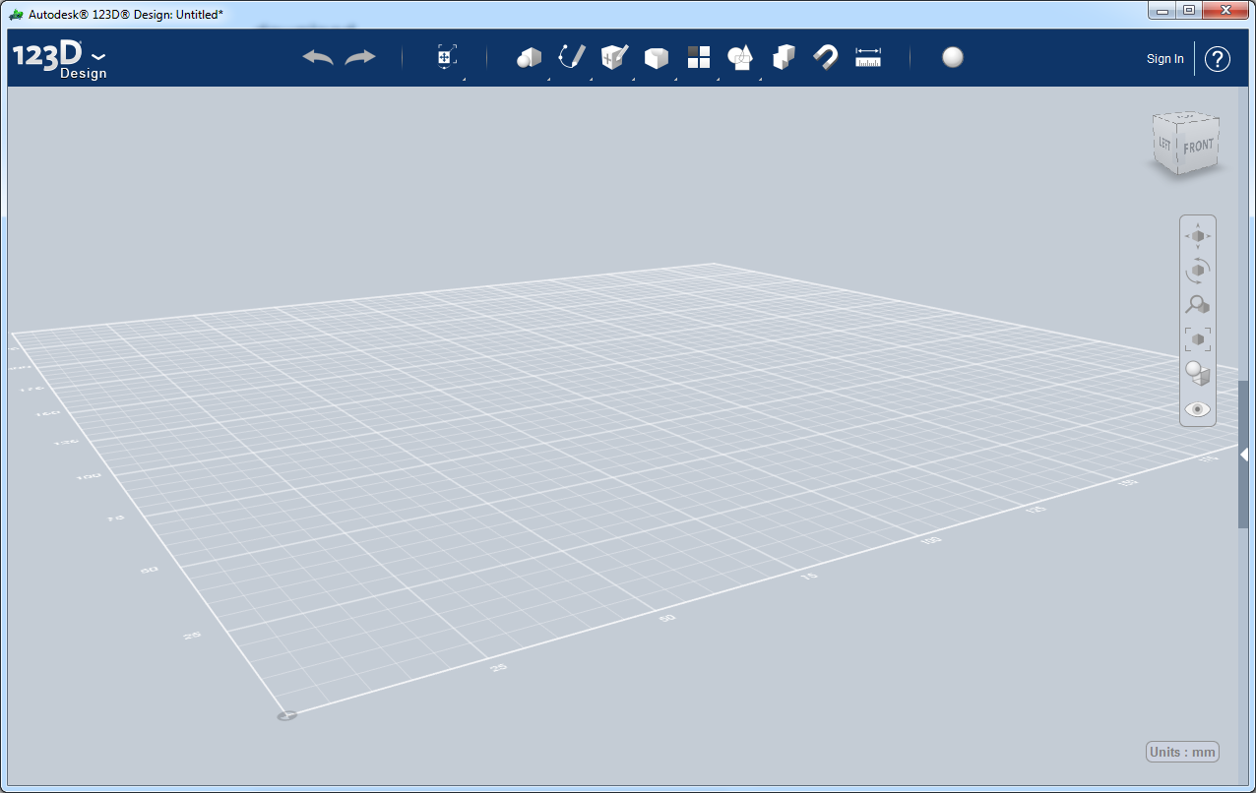
Start designing
Find some software. AutoDesk 123D Design is great
  Easy to use
  Simple interface
  Feature rich
  Free
  PC or MAC (also online and iPad)
  Don’t take my word on it try them all and find the best tool for the job

Slide 12
Draw with 3D Objects
Great for artistic drawing
Think in 3D draw in 3D
Draw complex 3D shapes
Draw backs
  Can get into trouble printing complex shapes may need to slice objects and glue assemble them
  Hard/impossible to draw to precise dimensions
  Personally I find it less useful (will not focus on it in this presentation)

Slide 13
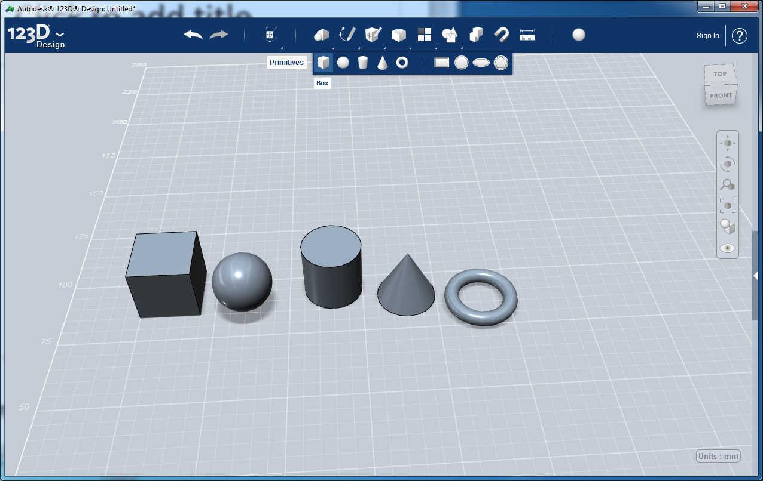
3D Drawing - Simple 3D shapes

Slide 14
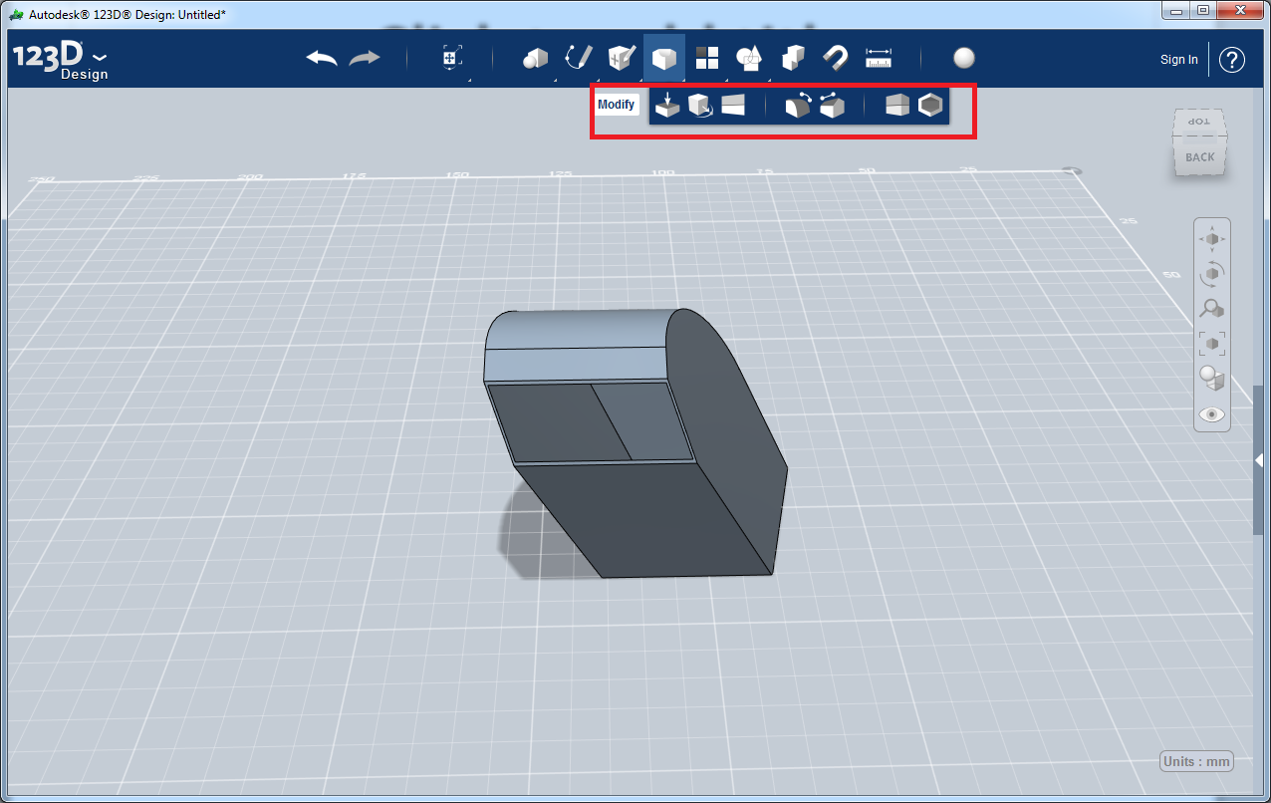
Modify 3D Shapes

Slide 15
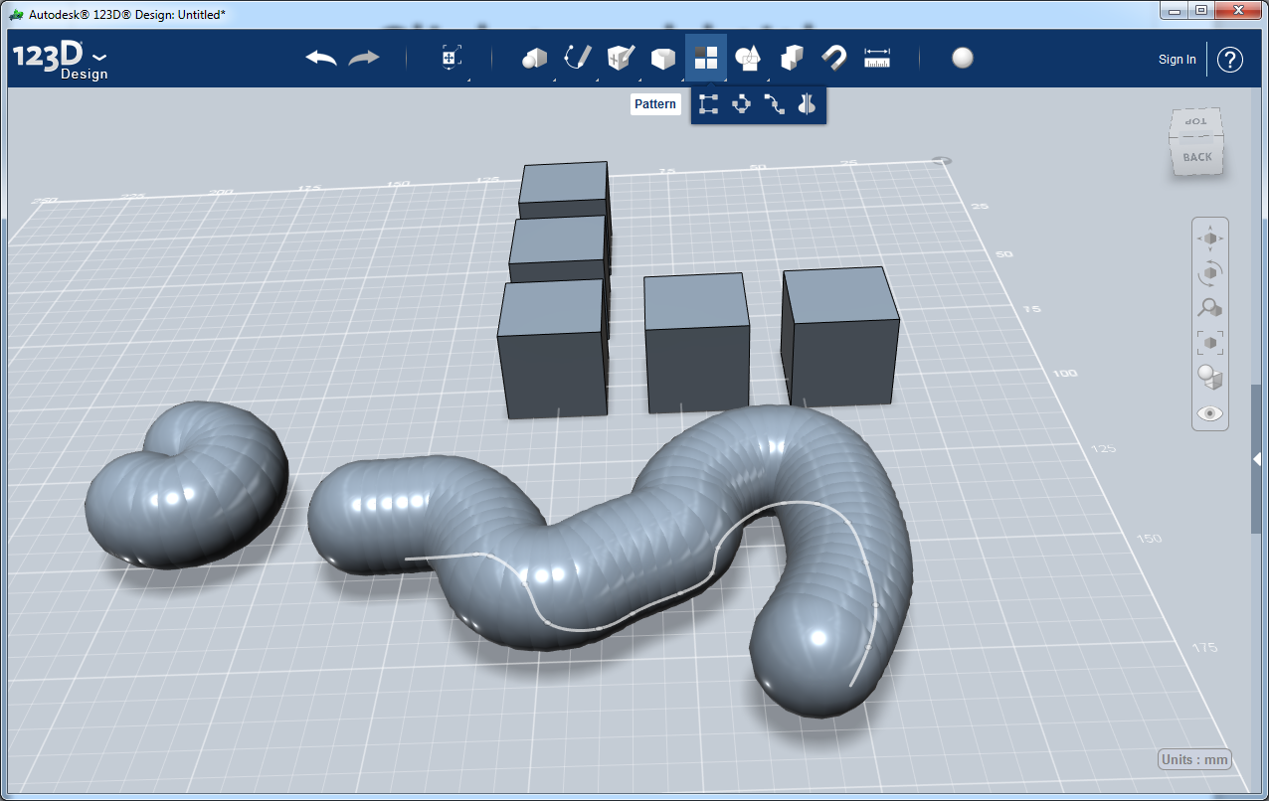
Shape Patterns

Slide 16
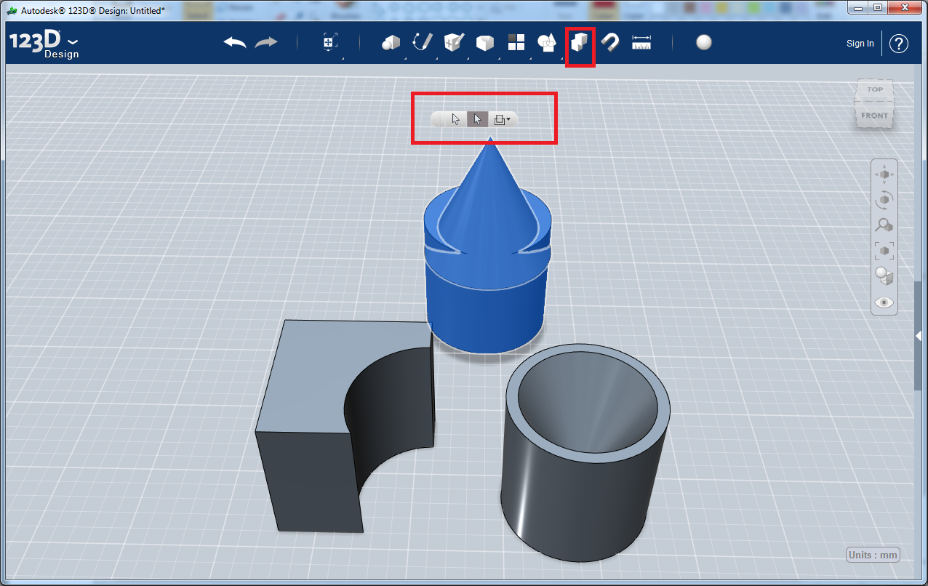
Combine and Subtract

Slide 17
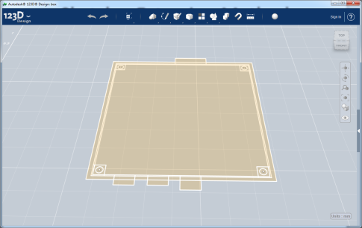
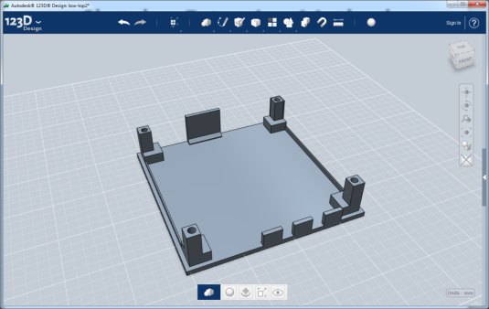
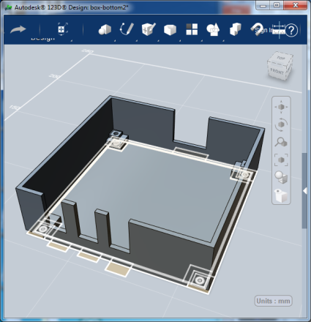
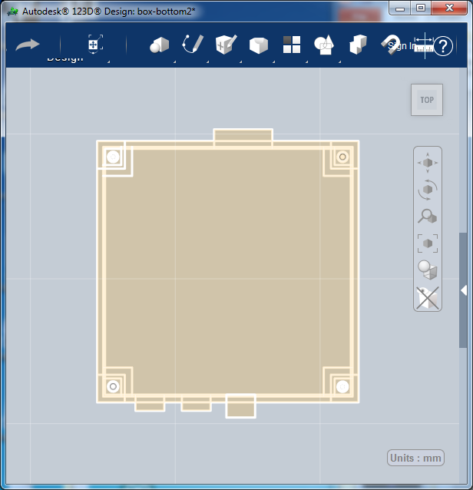
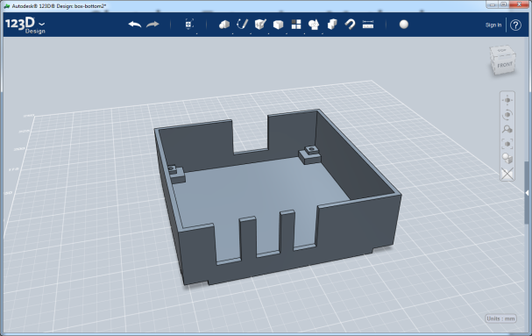
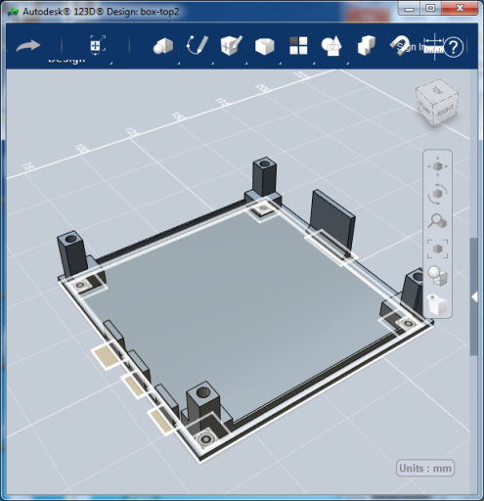
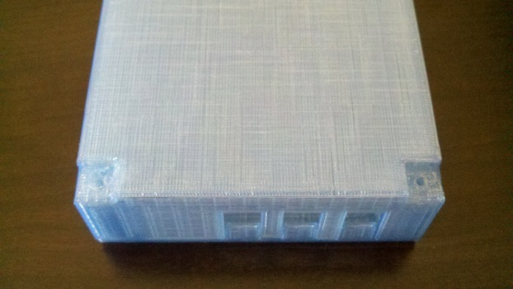
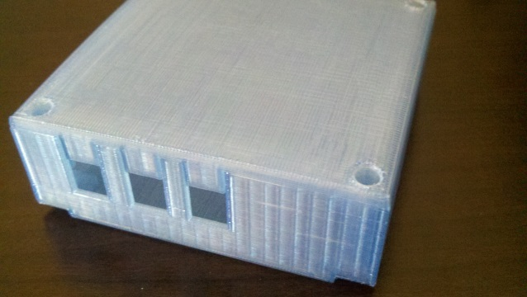
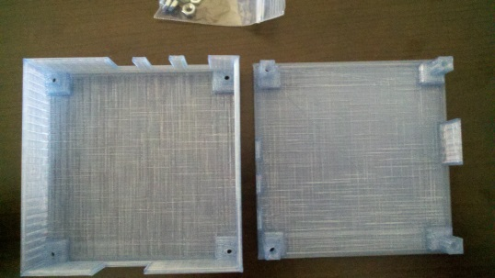
Sketch – Extrusion Method

Slide 18
Sketch – Extrusion Method
Great for technical drawing
Easy to manipulate
Draw to precise dimensions and specs
Mostly easier to think in 2D
Not good for complex 3D shapes
Two step process
  Draw all necessary shapes in 2D (Sketch Mode)
  Extrude the 2D shapes into 3D

Slide 19
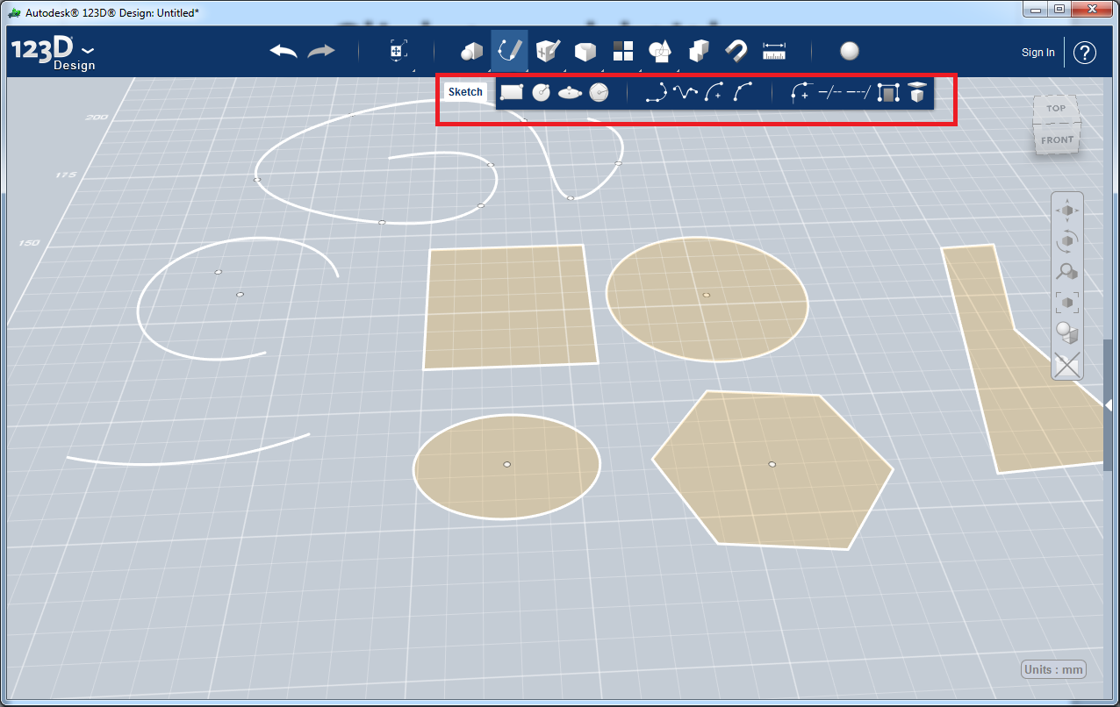
2D Shapes

Slide 20
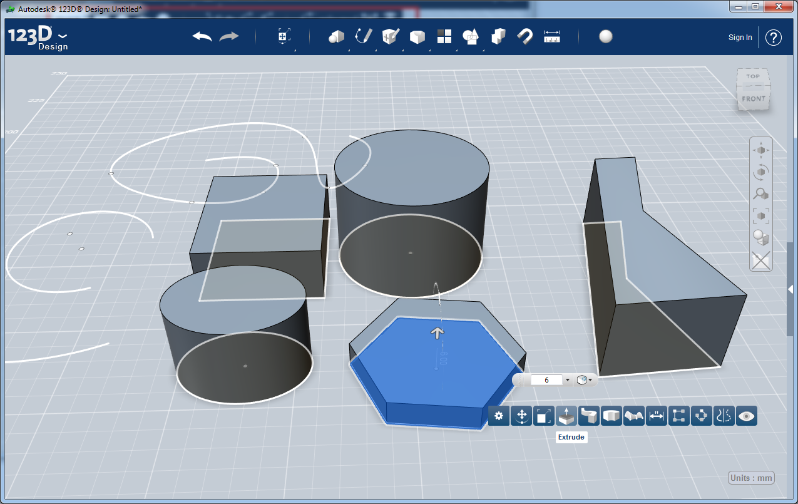
Extrude 2D Shapes

Slide 21
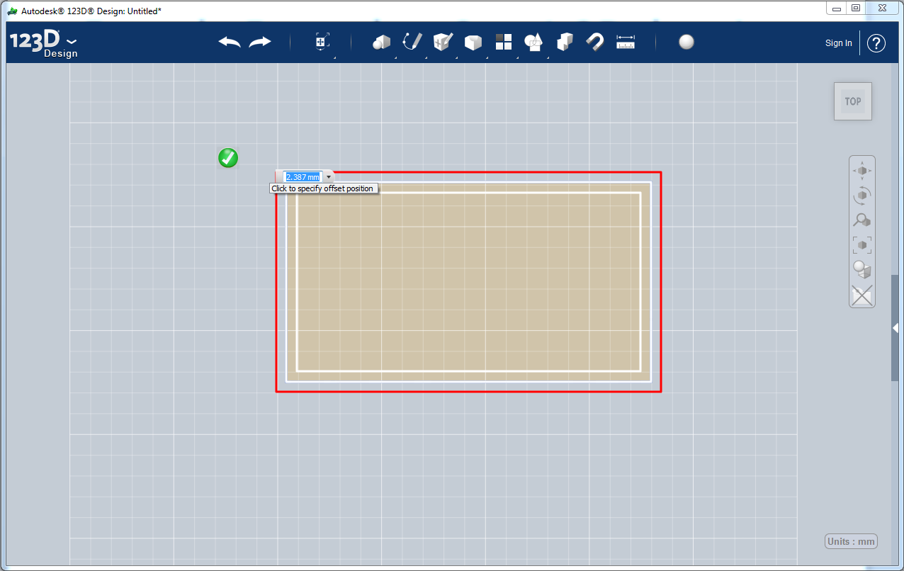
Extrude Example – Step1 2D drawing

Slide 22
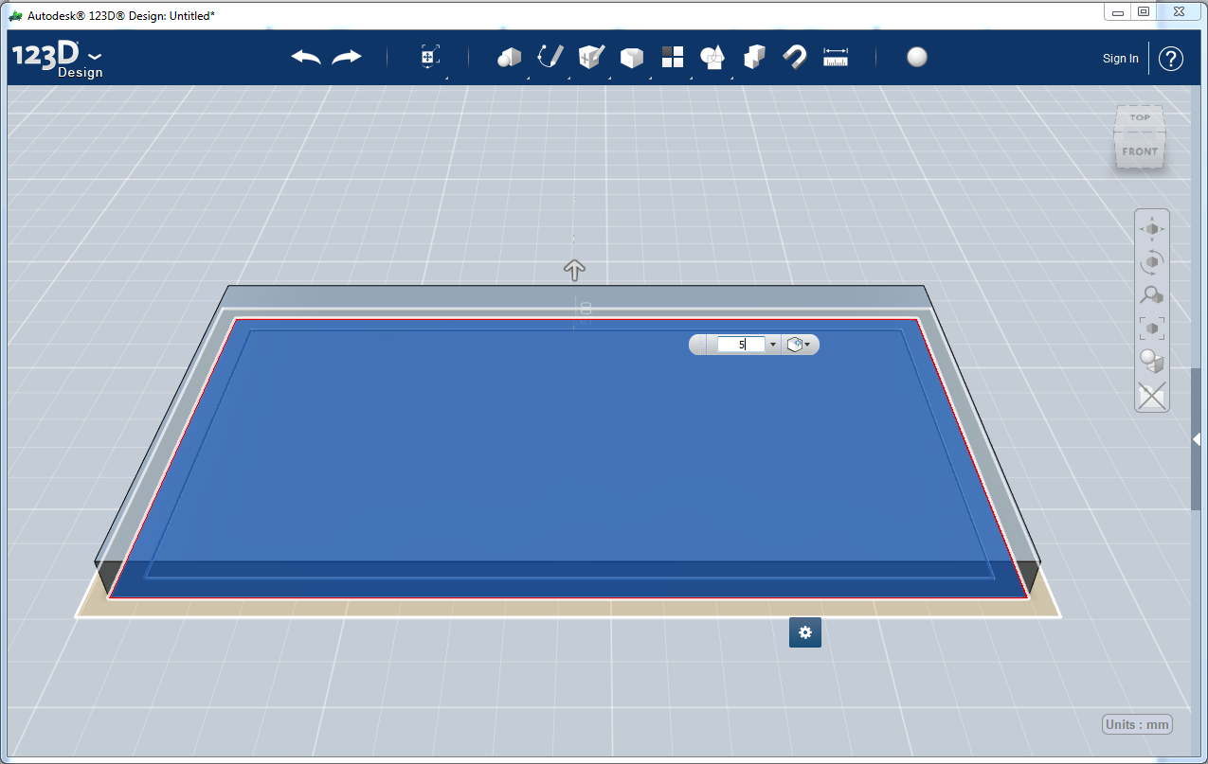
Extrude Example – Step2 Extruding

Slide 23
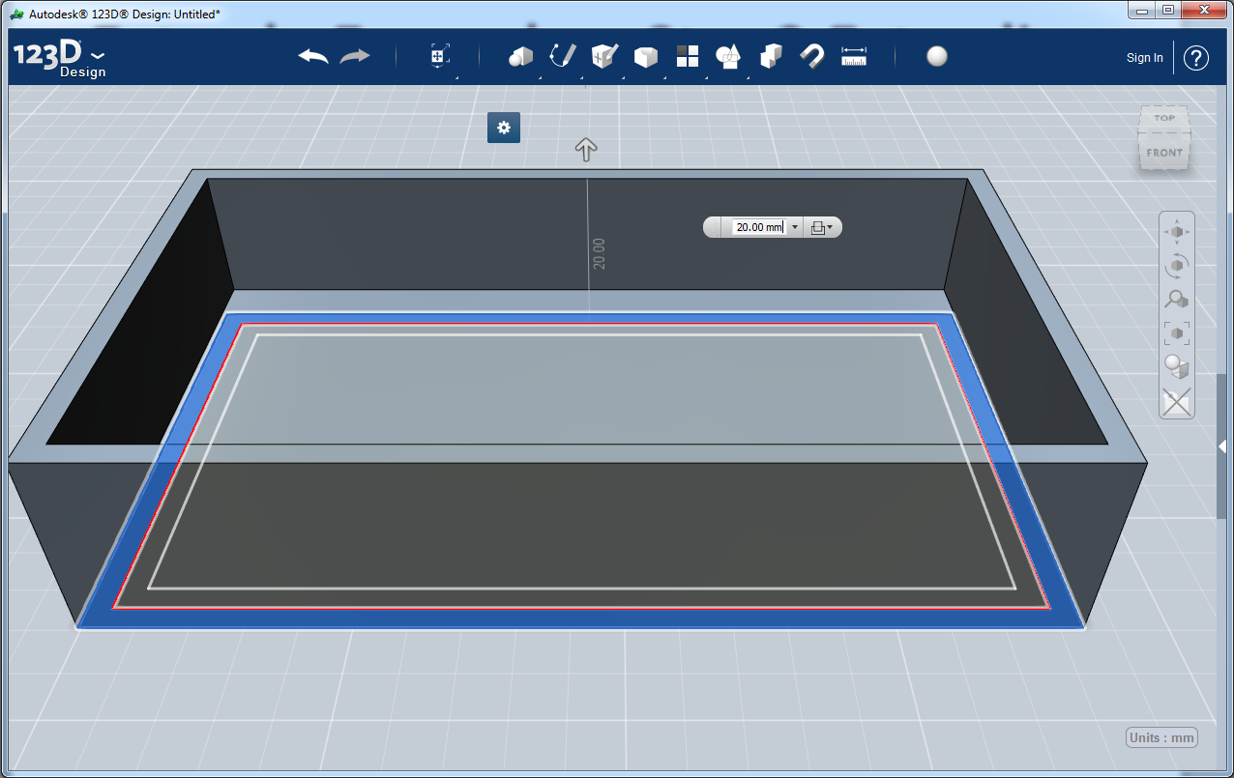
Extrude Example – Step2 Extruding

Slide 24
Extruding Details
When 2D drawing try to add all features of the 3D object before extruding
Remember to add airspace/wiggle room
Extruding into an existing 3D solid subtracts from the solid
Remember to Join all extrusions into one solid
Export you solids to .STL files for printing
Share your design on Thingiverse!!!

Slide 25
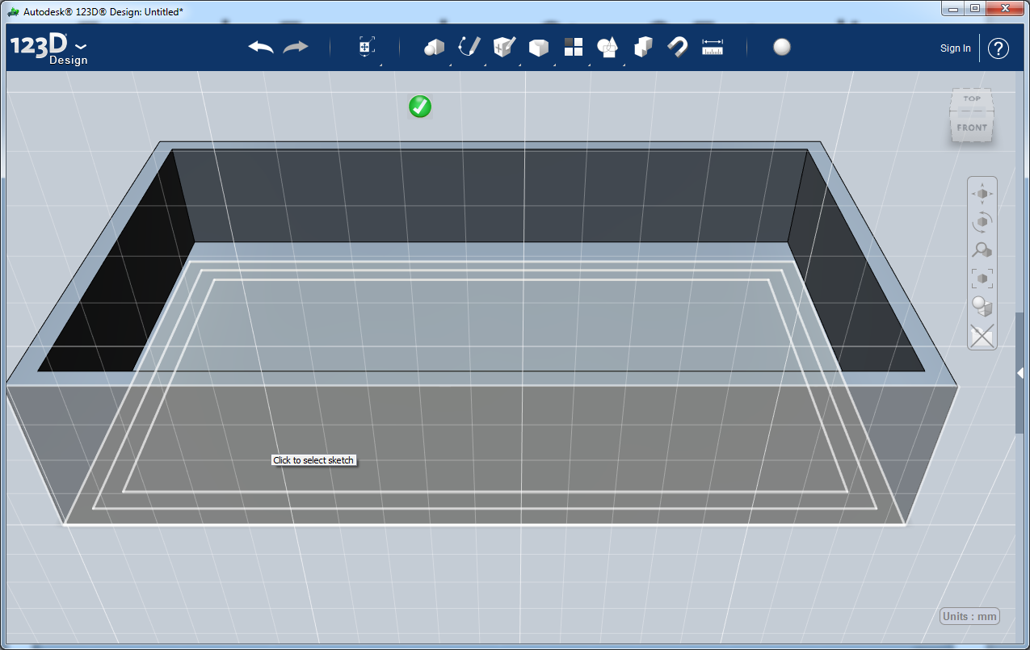
Sketching on solids – Select Plane

Slide 26
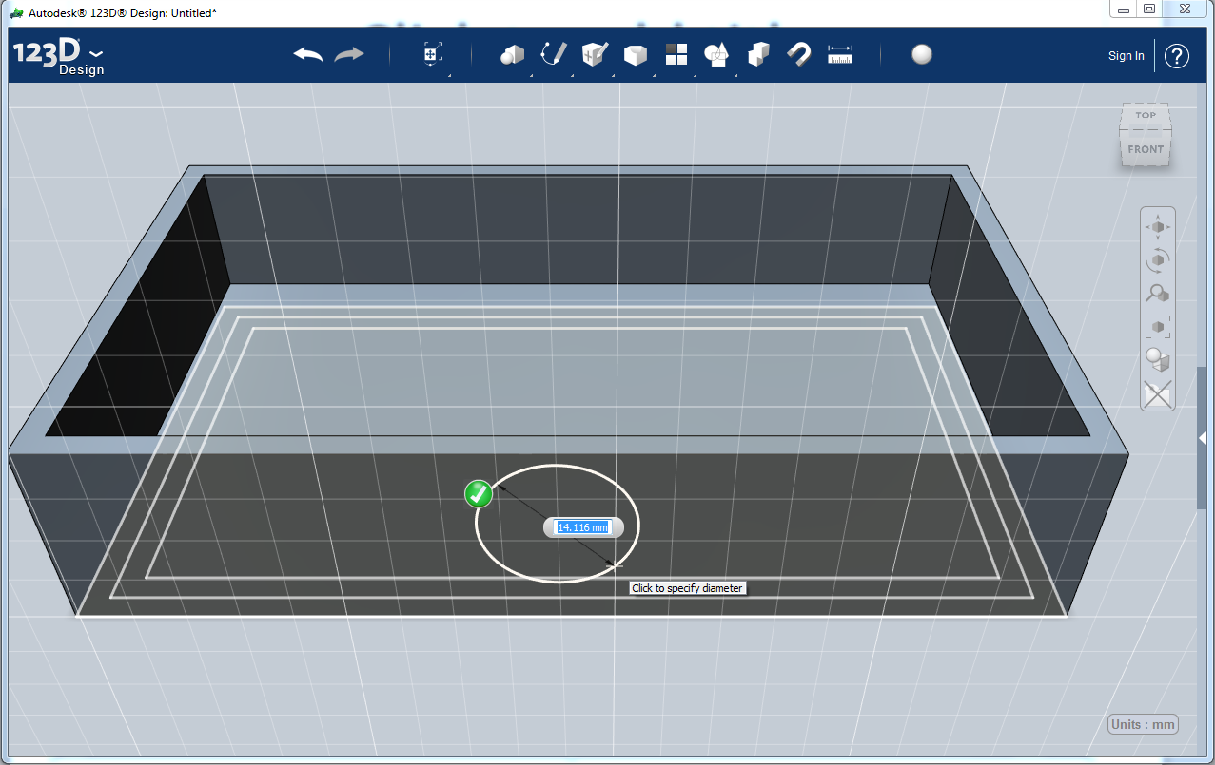
Sketching on solids - Draw

Slide 27
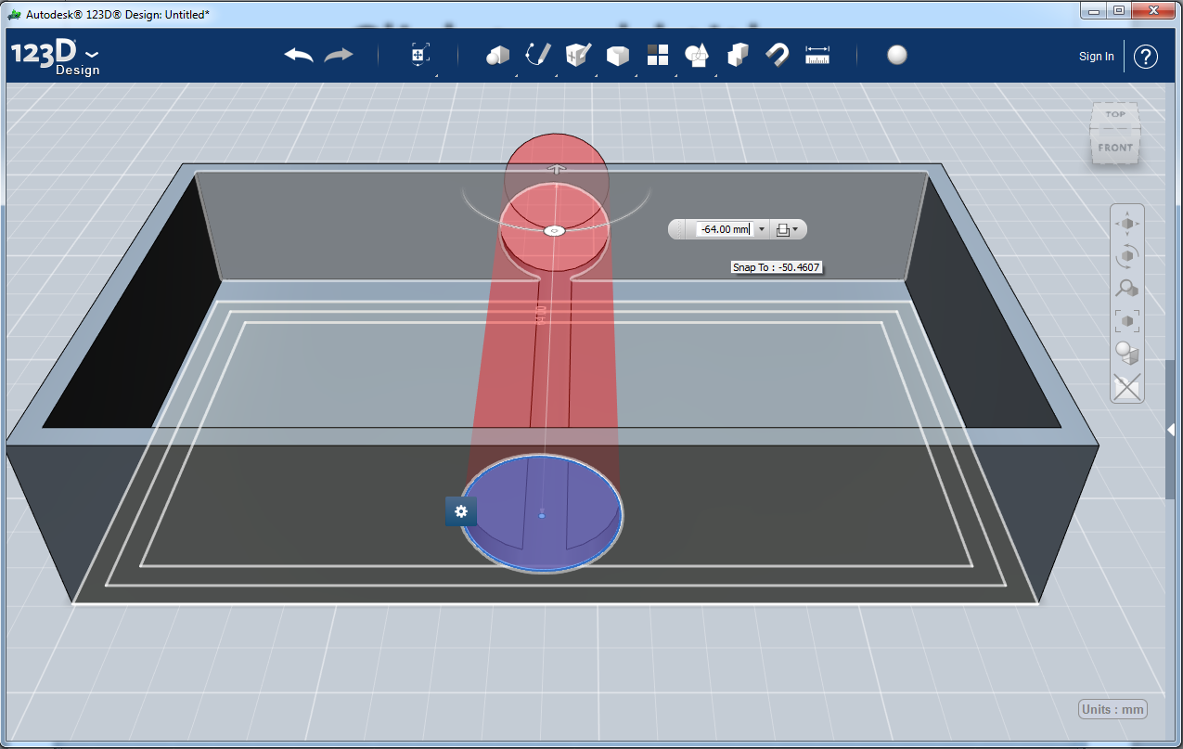
Sketching on solids - Extrude

Slide 28
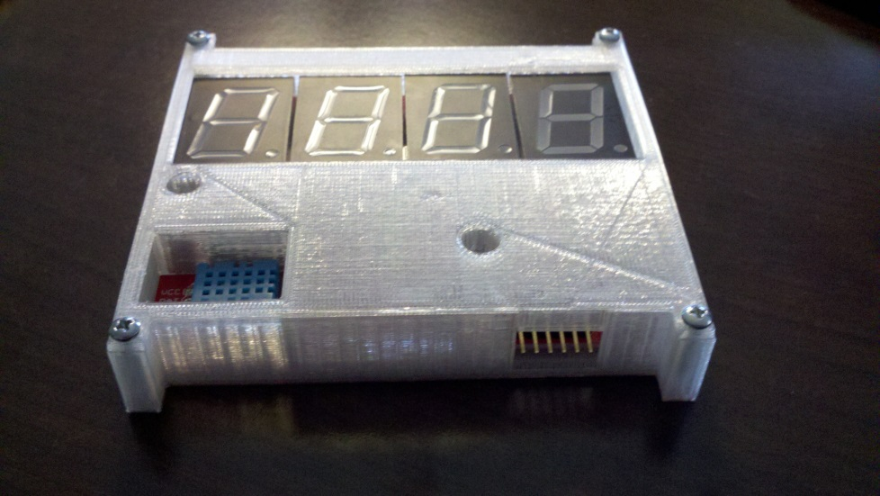
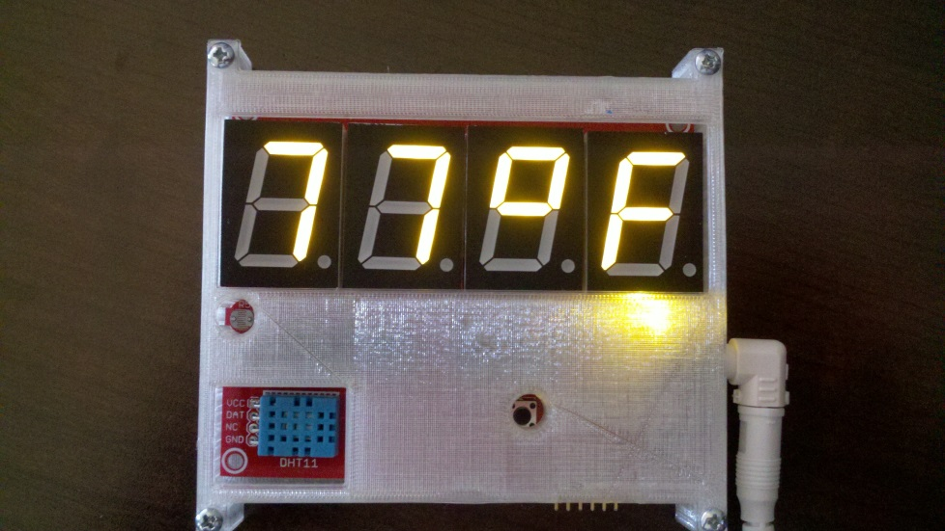
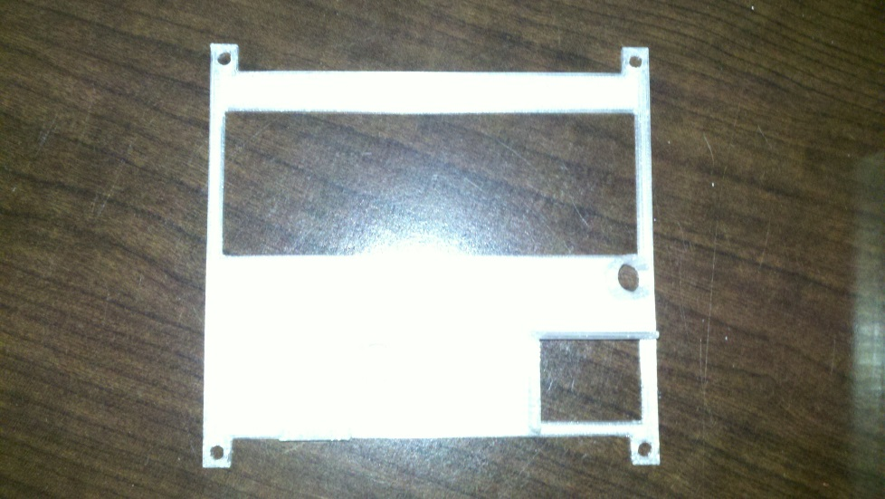
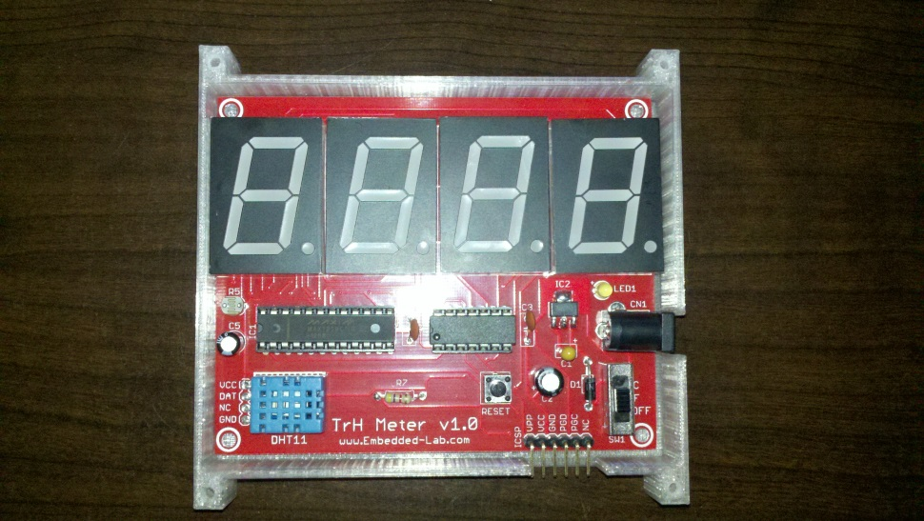
Advanced Extrude Example TrH Meter
http://www.3dprintmd.com/print/3d-printed-case-for-the-trh-meter-update-1/

Slide 29
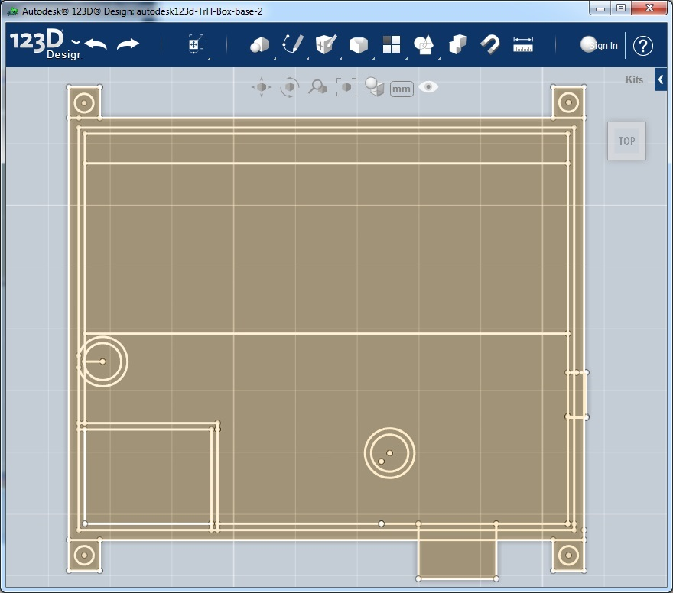
TrH Meter – Base Sketch

Slide 30
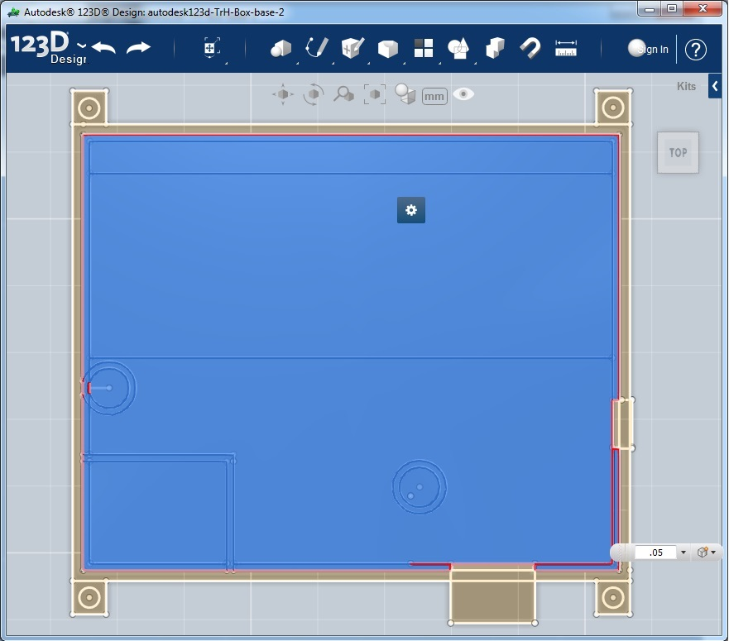
TrH Meter – Extrude Bottom

Slide 31
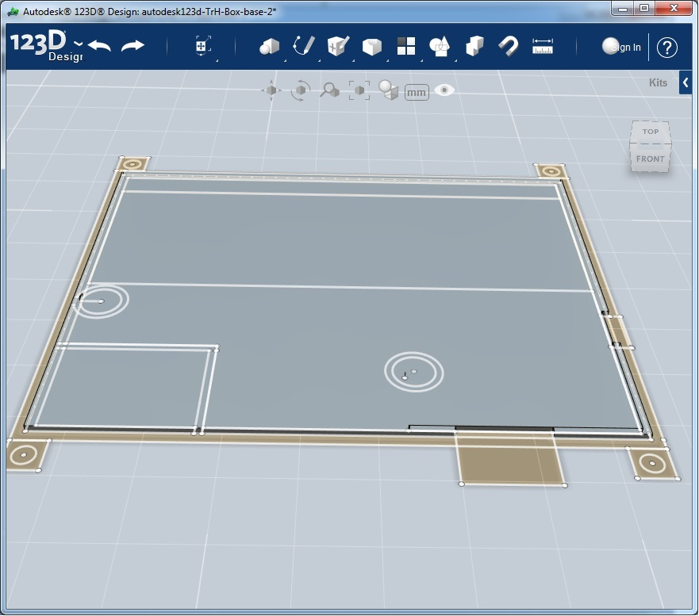
TrH Meter – Bottom Extruded

Slide 32
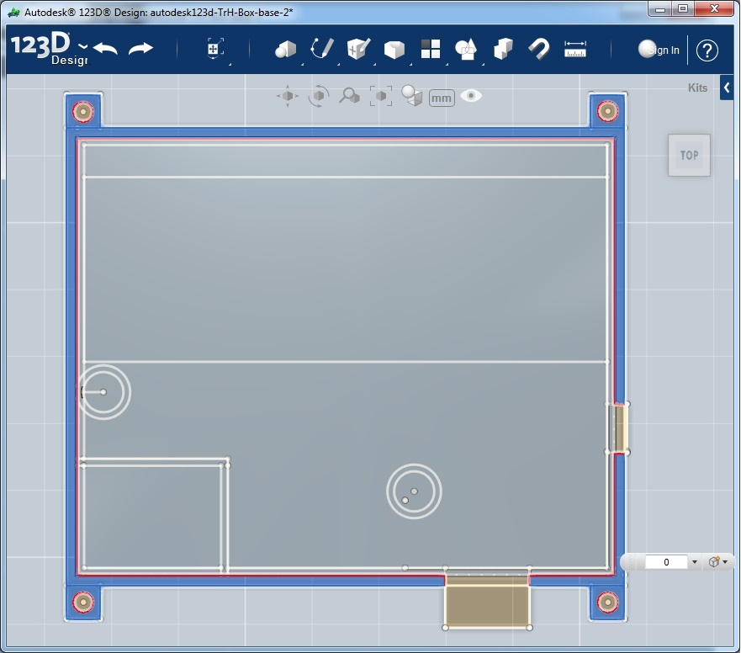
TrH Meter – Side Extrusion

Slide 33
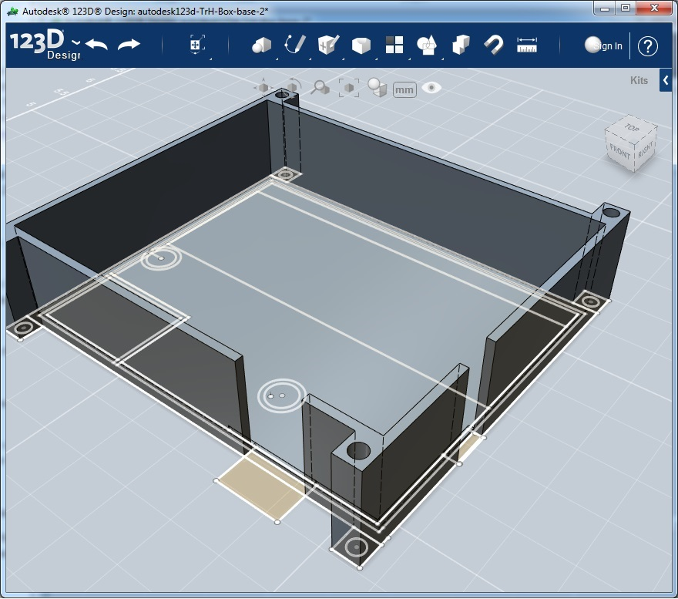
TrH Meter – Sides Extruded

Slide 34
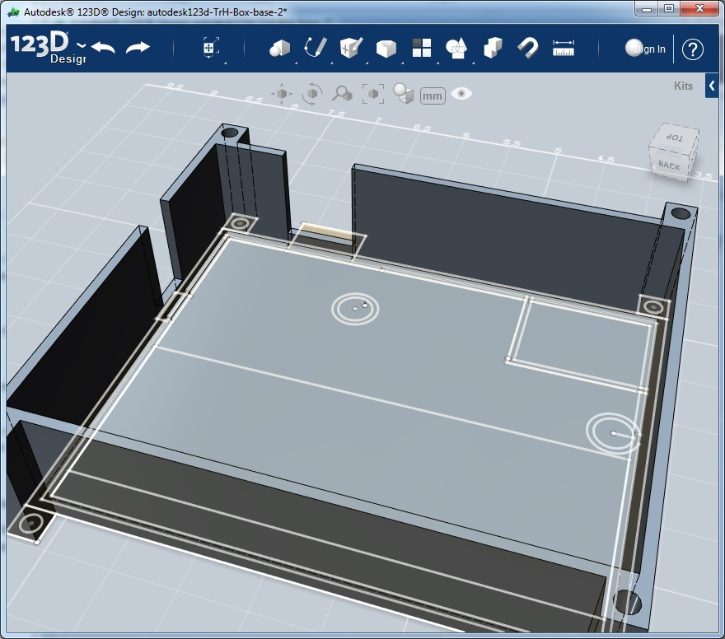
TrH Meter – Side Holes Filled

Slide 35
TrH Meter – Start with Base For Top

Slide 36

TrH Meter – Top Extrusion

Slide 37

TrH Meter – Sensor Partition

Slide 38

TrH Meter – Reset button & light sensor

Slide 39

TrH Meter – Side Holes fill

Slide 40

TrH Meter – Move Up

Slide 41

TrH Meter – Rotate 180 degrees

Slide 42

Online tools – Smart Primitives

Slide 43

Online tools – Gears

Slide 44

Online tools – Other Stuff

Slide 45
Online Printing Services
Share it:
Thingiverse.com – open design exchange
Shapeways.com – buy and sell designs and prints
Get it made:
Makexyz.com – find a local printer for your design http:/www.makexyz.com/printer/michael_mcco
http://3dprintingpricecheck.com/ - compare printing service prices to have you design printed

Slide 46
Summary
3D printing is the new thing
  President Obama referenced 3D printing in the state of the union address this year
  Watch for continued rapid changes with the technology. Currently at the height of rapid change.
3D printing is rapidly becoming practical
  Technology is progressing leaps and bounds
Design is quick and easy
  Well with in reach of the hobbyist
  Technology progression is matching 3D printing’s revolution

Slide 47
Practical Demonstration
Lets design something!!!

